Slide 1
Alberta Business Beat
Volume 3, September/October 2013
INTERNAL with notes
Notes:
Results from our third quarterly survey with small and mid size businesses in Alberta.

Slide 2
Background and Methodology

Slide 3
Background & Objectives
Background
ATB Financial commissioned NRG Research Group to conduct a survey of 300 randomly selected small- to medium-sized businesses in Alberta each quarter, beginning in Q2-FY2014.
The purpose of the study is to gain an understanding the challenges faced by small- to medium-sized businesses in Alberta, and to track confidence in the business climate in Alberta.
Research Objectives
Measure business owners and managers’ perceptions of the current business climate compared with six months ago, as well as their assessments of what the business climate will be like six months from now;
Understand the impact of the June flooding for small to medium-sized businesses;
Gauge the likelihood of their company’s future investment plans;
Determine best advice for a start-up to succeed; and,
Uncover the barriers for growth for small-sized businesses; and,
Profile the firmographics as well as respondent demographics for small- to medium-sized businesses in Alberta.

Slide 4
Methodology
Qualifying Businesses
< 500 employees
<$20 million annual revenues
Must be financial decision makers or influencers
Excluded agriculture, government, financial institutions, media, market research, PR, advertising and communications sectors
Field dates:
Aug 22 – Sept 4, 2013
Telephone + online option
Over 3,000 businesses contacts made and 300 completed the survey
Margin of error is +/- 5.8%
Randomly selected Alberta SME’s

Slide 5
Key Insights
1
Best advice for start-ups is to focus on getting ‘the basics’ right
2
Expectations for the Alberta economy are just taking off
3
Recovery from the flood continues, but growth plans were not affected

Slide 6
Alberta Small Business Profile 2013

Slide 7
Half of Alberta SMEs earn revenues in excess of $1,000,000
Of the SMEs we surveyed, half (49%) report fewer than five employees and half (49%) report 2012 earnings in excess of $1,000,000.
Number of Employees
Annual Revenues 2012
Source: ATB Financial, Survey on Alberta SMEs, Jan/May/Aug-Sept 2013; 906 respondents.

Slide 8
72% of SMEs are TRYING to grow their business
Business Firmographics
Business Life Stage Phase
Intentional Growth
Source: ATB Financial, Survey on Alberta SMEs, Jan/May/Aug-Sept 2013; 906 respondents.

Slide 9
Business Firmographics
Borrowing Needs
# of Years in Operation
MEAN
25 years
$1MM+
11%
Source: ATB Financial, Survey on Alberta SMEs, Jan/May/Aug-Sept 2013; 906 respondents.

Slide 10
Business Firmographics
8% of SMEs are franchises
Industry
Franchise Industry
Retail | 30%
Automotive | 17%
Food Services | 9%
Health | 7%
Non-profit | 7%
Travel, Leisure & Accommodation | 6%
Beauty & Fitness | 4%
Energy/ Oil & Gas Services | 4%
Financial Services/ Insurance | 3%
Source: ATB Financial, Survey on Alberta SMEs, Jan/May/Aug-Sept 2013; 906 respondents, responses of 3% or more are shown.

Slide 11
49% of SMEs only conduct business in Alberta
Business Firmographics
Business Location(s)
Business Scope
Source: ATB Financial, Survey on Alberta SMEs, Jan/May/Aug-Sept 2013; 906 respondents.

Slide 12
Business Firmographics
Does your business have a store front?*
* asked only in Aug-Sept 2013
Source: ATB Financial, Survey on Alberta SMEs, Aug-Sept 2013, with 300 respondents.

Slide 13
Respondent Demographics
35%
55+
Title/ Role
Age
Source: ATB Financial, Survey on Alberta SMEs, Jan/May/Aug-Sept 2013; 906 respondents, responses of 3% or more are shown.

Slide 14
Respondent Demographics
Role in Financial Decisions
Gender
Source: ATB Financial, Survey on Alberta SMEs, Jan/May/Aug-Sept 2013; 906 respondents.

Slide 15
Best Advice for Start-up Success

Slide 16
Best advice for start-up success from established businesses
“MANAGE CASH FLOW, BECAUSE IT'S YOUR LIFELINE. IF YOU HAVE NO CASH THEN YOUR BUSINESS IS DONE PRETTY QUICKLY.
”
CFO, Energy/Oil & Gas Company,
10 years in business,
$20MM+ in revenues.
Source: ATB Financial, Survey on Alberta SMEs, Aug/Sept 2013, 300 respondents, responses mentioned by 3% or more are shown.
Notes:
This quarter we asked businesses who have been operating for 5+ years what TOP 2 tips would they offer another business like theirs, who was just starting out?
There were some interesting trends…
In addition to…
Seek professional advice/ input (2%);
Have a clear value proposition (1%);
Secure additional financing (1%);
Plan for unfavourable situation (1%);
Have integrity (1%);
Embrace change/ take a risk (1%);
Diversity of clients (1%);
Be in a good location (1%);
Give back to the community (1%);
Single mentions: make it easy for clients to do business with you and follow your heart/dreams.

Slide 17
Reasons for Becoming an Entrepreneur

Slide 18
What I love about owning/ running/ being responsible for an independent business is…
47% of SME owner/operators report … The ability to make my own decisions
13% Control over own business
12% Flexibility of hours
“I LIKE TO BE ABLE TO CONTROL WHAT HAPPENS IN THE BUSINESS AND WITH OWNING A BUSINESS YOU HAVE SOME CHOICES AND FREEDOMS AND ARE IN CONTROL OF YOUR OWN DESTINY.
”
Pharmacy Owner
35 years in business,
$1MM - $3MM in revenue.
Source: ATB Financial, Survey on Alberta SMEs, Aug/Sept 2013, 98 respondents.
Notes:
Additional sentence completions…
9% The challenge of running a business;
8% Helping the community/ others;
3% The ability to adapt to changes; and,
2% The sense of accomplishment.

Slide 19
Barriers for Growth of Small-Sized Business

Slide 20
Uncovering the greatest barriers to grow for small-sized businesses
47%
20%
17%
13%
11%
10%
9%
8%
6%
6%
6%
4%
Source: ATB Financial, Survey on Alberta SMEs, Aug/Sept 2013, 300 respondents, total responses mentioned by 4% or more are shown.
.
Notes:
Additional total mentions include:
Location (3%);
The need to acquire new technology (2%);
Mis-alignment of owners, partners or executive (2%).

Slide 21
Impact of the June 2013 flood

Slide 22
The impact from the flood was far reaching
21%
say their business was negatively impacted by this event (‘greatly/somewhat’)
Source: ATB Financial, Survey on Alberta SMEs, Aug/Sept 2013, 300 respondents.
Notes:
Survey question: “In June of this year, Alberta experienced heavy rainfall that triggered flooding in a number of communities including Canmore, Calgary and High River. Would you say your business was not impacted, negatively impacted or positively impacted by this event?”

Slide 23
This is the slide that contradicts the economy optimism growth. Potentially a leading question to be removed from the deck.
Expected future impact on the Alberta economy is considerable
60%
…anticipate the flooding will still be impacting the Alberta economy six months from now.
Source: ATB Financial, Survey on Alberta SMEs, Aug/Sept 2013, 300 respondents.
Notes:
Survey question: “How do you think the flooding will impact the Alberta economy six months from now? Will it have…?”

Slide 24
Those negatively impacted felt the greatest effect on their revenues
“HOW WAS YOUR BUSINESS NEGATIVELY IMPACTED?”
Among the 21% of businesses who were negatively impacted, 40% experienced either a loss in revenue or had additional expenditures.
Source: ATB Financial, Survey on Alberta SMEs, Aug/Sept 2013; among those negatively impacted; 64 respondents.
Notes:
For those businesses reporting being NEGATIVELY impacted, we follow-up with “ How was your business impacted?”
Direct economic impact - revenues (eg, revenues reduced or increased; shut down for few days/ many days/ permanently; fewer customers; more customers)
Physically impacted (eg, power outage; water damaged equipment/ inventory/ building)
Operationally impacted (eg, needed immediate access to capital to pay for repairs; loan payment deferred; supplier delays; accounts receivables overdue)
Indirect economic impact (eg, property value depreciation; supply/demand issues for inventory cause consumer prices to rise)
Direct economic impact - expenditures (eg, output of expenses; lay off staff; clean up services; moving of materials; new equipment needed; new office space)

Slide 25
The majority of SMEs negatively impacted expect to fully recover within six months
“IN SIX MONTHS’ TIME, DO YOU FEEL YOUR BUSINESS WILL…?”
Source: ATB Financial, Survey on Alberta SMEs, Aug/Sept 2013; among those negatively impacted; 64 respondents.

Slide 26
FLOOD NEGATIVELY IMPACTED BUSINESS
“There was no business because tourists couldn’t come here. The roads were closed. People where concerned that Canmore was totally destroyed.
”
Owner, Bed & Breakfast,
18 years in operation,
Less than $250k in revenue.
FLOOD POSITIVELY IMPACTED BUSINESS
“We had massive loads of appliances going to High River and Calgary for replacement of damaged ones.
”
General Manager, Family Trucking Business,
30 years in operation,
$1MM to $3MM in revenue.
Source: ATB Financial, Survey on Alberta SMEs, Aug/Sept 2013; among those negatively (n=64) or positively impacted (n=29).

Slide 27
Business Confidence

Slide 28
A very optimistic future
“HOW DO YOU THINK… WILL BE SIX MONTHS FROM NOW?”
Alberta Economy
Your Company
87%
+10
89%
n/c
will be better off or the same
will be better off or the same
(±) Change from last quarter
Source: ATB Financial, Survey on Alberta SMEs, Aug/Sept 2013, 300 respondents.
Notes:
The glass continues to remain ½ full for Alberta small and mid-sized business owners
ALBERTA ECONOMY: 87% of businesses expect the overall Alberta economy to be better off or the same six months from now; That is up by 10 percentage points over last quarter; being driven by optimism in the Retail industry followed by Energy. Optimism with Construction balked the trend and fell considerably this quarter.
THEIR COMPANY: and 89% expect their company to be better off or the same six months from now. No change from last quarter.

Slide 29
Introducing the ATB Business Beat Optimism Indicators
Retail +17.7
Energy +4.4
Construction -13.1
ATB Business Beat Optimism and CFIB Business Barometer Indices
Index (0-100)
More optimistic about future performance
Less optimistic about future performance
Data time periods: Q1 = Jan 2013, Q2 = May 2013 & Q3 = Aug 2013
Source: ATB Financial, Survey on Alberta SMEs 2013; CFIB Business Barometer Index 2013.
Notes:
With the release of our third volume of the ATB Business Beat, we now have some trending to share with two newly formulated Optimism Indices.
We felt it was important to ask businesses about their expectations for their company’s future performance and also where they see the Alberta economy heading.
The results are in with Q3 and you can see that our ATB Business Optimism Index fully tracks along side the popular Business Barometer Index from the CFIB. Our most recent survey was fielded from Aug 22 – Sept 4 2013 and netted a SME Business Optimism score of 69.8. This is considered to be a very high level of optimism and fortunately it appears to be the status quo for Alberta.
According to the CFIB, one would normally see an index level of between 65 and 70 when the economy is growing at its potential. In fact, you can see here that Alberta SME’s optimism about the Alberta economy is also strong and continues to grow substantially with each quarter, reaching its highest level this year with a 66.2. The gain of 2.4 points from last quarter is being driven by strong optimism seen in the Retail and Energy sectors. Unfortunately, optimism about the economy from SMEs in the Construction industry did not echo the same sentiment and fell considerably this quarter.
So what do the numbers mean? Well, each index is measured on a scale of 0 and 100 and can be interpreted as follows:
ATB – Business Optimism Index: a score above 50 means owners expecting their business’ performance to be stronger in the next 6 months outnumber those expecting weaker performance.
ATB – Economy Optimism Index: a score above 50 means owners expecting the Alberta economy to be stronger in the next 6 months outnumber those expecting weaker performance.
CFIB – Business Barometer Index: a score above 50 means owners (CFIB members) expecting their business’ performance to be stronger in the next 12 months outnumber those expecting weaker performance. One normally sees an index level of between 65 and 70 when the economy is growing at its potential.
Q1.2 “Considering everything, would you say your company will be better off, the same or worse off financially 6 months from now?”
Q1.4 “And again considering everything, would you say the overall Alberta economy will be better off, the same or worse off financially in the next 6 months?”
Data sources:
Q1 ATB Business Beat: Jan 22-31, 2013;
Q2 ATB Business Beat: May 1-15, 2013;
Q3 ATB Business Beat: Aug 22-Sept 4, 2013.
Q1 CFIB: Jan 2013 – Alberta Business Barometer Index;
Q2 CFIB: May 2013– Alberta Business Barometer Index;
Q3 CFIB: Aug 2013– Alberta Business Barometer Index.

Slide 30
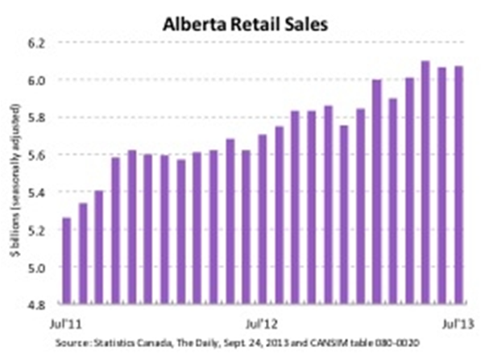
Shoppers show confidence in July
Source: ATB Daily Economic Comment, Todd Hirsch – Sept 24, 2013
Notes:
Shoppers show confidence in July
Various indicators provide insights into the overall health of the economy, but few do as good a job of revealing consumer sentiment as retail sales. And, new data shows that Albertans are speaking loudly – and confidently – with their wallets.
Shoppers throughout the province rang up just under $6.1-billion in sales in July, matching June's pace and coming in slightly below the all-time record set in May (see chart). Statistics Canada adjusts the sales figure to account for seasonality. Over the last twelve months, total retail sales are 6.1 per cent higher than the previous twelve-month period. The trend can be partly attributed to inflation since rising prices pushes retail sales higher even if shoppers don’t buy any more goods than usual. In July, the consumer price index rose 2.2 per cent (although it fell back down to 1.4 per cent in August). More people moving to Alberta also automatically lifts retail sales. Alberta’s population in the second quarter of 2013 was 3.2 per cent higher than the previous year, according to Statscan. Despite price increases and population growth, Alberta shoppers are still spending more per person than they were a year ago. Why? Higher wages and stronger job market confidence. With annual earnings in the province still increasing by between 4- and 5-per-cent, and an unemployment rate hovering close to 4.5 per cent, Alberta shoppers are feeling optimistic about their current – and future – income prospects.

Slide 31
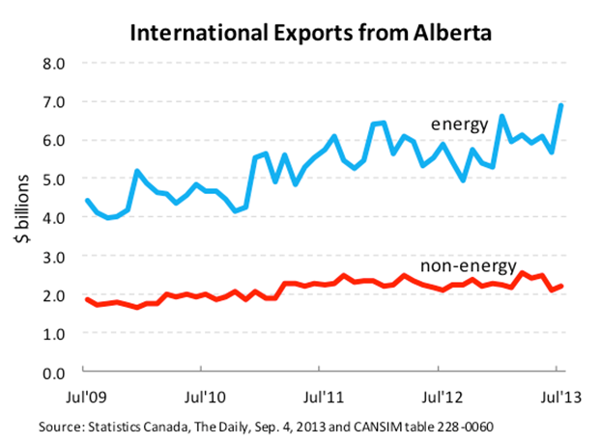
Oil sends sales soaring
Source: ATB Daily Economic Comment, Todd Hirsch – Sept 4, 2013
Notes:
Oil sends sales soaring
As far as Canadian provinces go, Alberta is one of the most dependent on selling its exports to the rest of the world. While overall exports have struggled over the last year, they took a strong turn for the better in July. The value of exports from our province rose to $9.1 billion, 17.3 per cent greater than the previous month. But in spite of this on-month lift, sales from Alberta over the most recent 12 months are up only 0.5 per cent compared to the previous 12 months. Almost all the gain in exports in July was due to a surge in the value of energy exports. Sales of oil and natural gas spiked 21.8 per cent month over month, and all of that was because of rising prices. The price of Western Canadian Select Blend (WCSB), which is the best benchmark for producers selling Alberta oil, rose in tandem with the U.S. benchmark price. Non-energy exports from Alberta—which is made up mostly of agricultural products, specialized machinery and fabricated metal products—also ticked higher by 4.9 per cent. However, the value of exports from these categories has failed to show much lift at all over the last several years. Looking ahead to August, we can expect our provincial exports to once again show some considerable lift. The U.S. benchmark price for oil has traded well above $US 100 per barrel for some time now as tensions in the Middle East rise. Even with the gap between U.S. prices and WCSB widening again, prices for Alberta producers remain quite good.

Slide 32
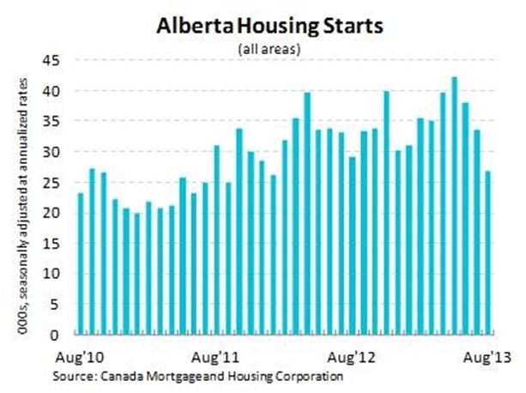
(Fewer) pretty pink houses for you and me
Source: ATB Daily Economic Comment, Todd Hirsch – Sept 10, 2013
Notes:
(Fewer) pretty pink houses for you and me
Autumn leaves were not the only thing that started to drop last month. According to the latest statistics, the number of homes being built in Alberta fell to an 18-month low. Construction started on 26,932 new homes in our province in August (adjusted for seasonality and at an annualized rate, meaning that if the pace set by builders in August continued for 12 months, there would be this many new homes during one year). That’s the slowest pace since January of 2012 and the third consecutive month of declines. The sharp pull-back in August is a bit of a mystery, particularly in light of yesterday’s report from Statistics Canada that residential building permits have been particularly strong in 2013. But there are a couple of possible explanations. The first has to do with the June flooding in Calgary and southern Alberta. There was already a pull-back in housing starts in July, followed by a larger drop in August. Perhaps skilled trades people such as carpenters and electricians—ones that would normally be required for new home construction—were pulled off their regular projects to assist with the immediate clean-up and rebuild of flood-ravaged homes. There could also have been a temporary shortage of building material such as panelboard and lumber, which might have delayed new builds. Another explanation is that the housing market is simply moving back into balance after an extremely active spring. While strong in-migration and rising wages have kept upward pressure on housing demand, builders know the problems that arise if too much product is put onto the market at once. Despite the summer slowdown, housing starts over the last 12 months are still 10.3 per cent higher than the previous 12-month period—suggesting the housing market is still healthy and balanced.

Slide 33
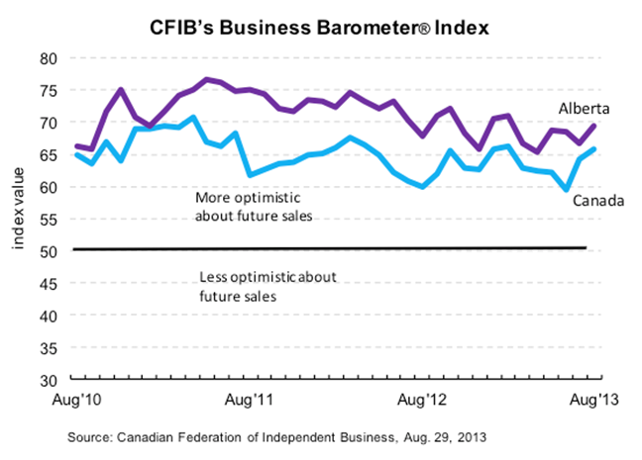
Independent businesses feeling the joy
Source: ATB Daily Economic Comment, Todd Hirsch – Sept 10, 2013
Notes:
Independent businesses feeling the joy
According to the Canadian Federation of Independent Business (CFIB), small- and medium-sized businesses in our province are more optimistic in August than they’ve been since the late winter. The index of optimism stood at 69.5, second among Canadian provinces only to Saskatchewan (70.7) and Newfoundland and Labrador (70.4). The CFIB notes that an index reading of between 65 and 70 is generally consistent with an economy growing at potential. The Canadian average among businesses was 65.9 in August, up 1.7 points from July and one of the highest points in a year-and-a-half. “Although we have noted a seesaw performance of late, Alberta’s small businesses have maintained above-average optimism relative to business owners in the rest of the country,” says the CFIB in its August provincial summary. This level of optimism corroborates the province’s generally good economic indicators such as rising energy prices, labour market statistics and construction activity. Even better, the province’s healthy levels of business optimism may be translating into further labour market gains in the future. “Short-term hiring plans remain very strong, with 28 per cent of respondents planning to add to their full-time staff and only 7 per cent planning to reduce staffing levels,” the CFIB says in its Alberta report.

Slide 34
Business Growth

Slide 35
OVER THE NEXT 24 MONTHS, DO YOU HAVE ANY PLANS TO…? “% YES”
Intentional growth is paying off
96% have not changed their investment plans because of the flood
75% of SMEs are intentionally trying to grow their business.
57% are seeing growth in their business as a result of their efforts.
12% are experiencing ‘organic’ growth.
Source: ATB Financial, Survey on Alberta SMEs, Aug/Sept2013, 300 respondents.
Notes:
A further sign that SMEs are feeling good about the future is their plans to grow
Three-quarters (75%) of SMEs are INTENTIONALLY trying to grow their business (up from 73% in May).
In fact, over half (57%) are seeing growth in their business as a result of their efforts (up from 52% in May).
An additional 12% are experiencing ‘organic growth’ not related to any intentional effort of their own. Growing in spite of themselves ☺ (same as 12% in May)
Future investment plans focus largely on the purchase of new equipment or machinery.
Six-in-ten (59%), of surveyed SMEs, plan on purchasing new company assets in the next 24 months (up from 53% in May).

Slide 36
Alberta Advantage

Slide 37
I believe the Alberta advantage is…
18% of SME owner/operators report the rich and diverse economy
13% The oil industry
10% Lots of job opportunities
“THE STABILITY OF THE LONG TERM ECONOMIC FACTORS AROUND THE PROVINCE. WE HAVE NEVER REALLY HAD A LONG TERM DOWNTURN IN OUR ECONOMY, SO WE HAVE ALWAYS MANAGED TO PULL OUT OF IT QUICKLY AND COME OUT ON TOP.
”
Owner, Construction Company,
37 years in business,
Less than $250k in revenue.
Source: ATB Financial, Survey on Alberta SMEs, Aug/Sept 2013, 97 respondents.
Notes:
Additional sentence completions…
8% The natural resources;
7% The people;
7% No provincial tax;
2% Limited government involvement; and
2% The entrepreneurial spirit.

Slide 38
What keeps me in Alberta is…
24% of SME owner/operators report … It is my home
14% The business opportunities
13% My family is here
“I WAS BORN AND RAISED HERE. I'M PROUD TO BE AN ALBERTAN. WE HAVE A STRONG ECONOMY AND IT'S THE BEST PLACE IN THE WORLD TO LIVE.
”
General Manager, Retail Business,
57 years in business,
Undisclosed revenue.
Source: ATB Financial, Survey on Alberta SMEs, Aug/Sept 2013, 99 respondents.
Notes:
Additional sentence completions…
12% The economy;
12% I like it here;
7% Low taxes;
6% My work;
4% Scenery;
3% Weather;
3% Lifestyle; and
2% The oil industry.

Slide 39
APPENDIX: Volume 3 - Firmographics and Respondent Demographics

Slide 40
Half of Alberta SMEs earn revenues in excess of $1,00,000
Of the SMEs we surveyed, nearly half report fewer than five employees, half (53%) report earnings in excess of $1,000,000 in 2012.
Annual Revenues 2012
Number of Employees
Change from last quarter
Source: ATB Financial, Survey on Alberta SMEs, Aug/Sept 2013, with 300 respondents.
Notes:
Number of Employees (from May):
0 to 4 (46%);
5 to 49 (45%);
50 to 499 (10%).
Revenues (from May):
<$250k (22%);
$250-<500k (14%);
$500k-<$1MM (16%);
$1-<$3MM (22%);
$3-<$10MM (13%);
$10MM+ (13%).

Slide 41
75% of SMEs are TRYING to grow their business
Business Firmographics
Business Life Stage Phase
Intentional Growth
Change from last quarter
Source: ATB Financial, Survey on Alberta SMEs, Aug/Sept 2013, with 300 respondents.
Notes:
Nearly six in ten SMEs (57%) would describe their business as being in the “Established Phase” (46%) or “Mature Phase” (11%) of its life cycle.
Businesses in the Established Phase are thriving companies with a loyal customer base; business life has become more routine.
The Mature Phase reflects companies with stable year over year revenue; however as sales start to fall off, owners are contemplating whether to expand or exit the business.
Life Stage (data from May):
Start-up (3%);
Initial Growth (7%);
Established (52%);
Expansion (17%);
Mature (15%);
Winding (6%).
Intentional Growth (data from May):
Intentional Growth (52%);
Organic (12%);
No Grow, Trying (21%);
No Grow, NOT Trying (15%).
SUBTOTAL: 73% of SMEs are TRYING to grow their business.

Slide 42
Business Firmographics
Borrowing Needs
# of Years in Operation
MEAN
24 years
$1MM+
10%
Change from last quarter
Source: ATB Financial, Survey on Alberta SMEs, Aug/Sept 2013, with 300 respondents.
Notes:
Years in Operation (from May):
1-5 (11%);
6-10 (19%);
11-15 (17%);
16-20 (12%);
20+ (42%).
MEAN 24 years.
Borrowing Needs (from May):
None (50%);
Less than $1MM (35%);
$1-<$3MM (3%);
$3-<$10MM (5%);
$10MM+ (2%);
Don’t know/ refused (7%).
Subtotal: $1MM+ (9%).
Alberta SMEs are well-established
The SMEs we talked to on average have been in operation in Alberta for 24 years. In fact, almost half (47%) have been in business more than 20 years.

Slide 43
Business Firmographics
7% of SMEs are franchises
Industry
Franchise Industry (n=20)
Retail | 9
Non-profit | 3
Automotive | 2
Food Services | 2
Health | 1
Business Services | 1
Other | 2
Change from last quarter
Source: ATB Financial, Survey on Alberta SMEs, Aug/Sept 2013, with 300 respondents, responses mentioned by 4% or more are shown.
Notes:
Franchise Industry (from May):
9% of SMEs are franchises.
Industry (from May):
Energy/Oil & Gas (13%);
Retail Trade (11%);
Construction (11%);
HST (11%);
Hospitality/Restaurant (9%);
Bus Services (5%);
T/W (5%);
Gov’t Services (4%);
Education (4%);
Art, Ent & Rec (3%);
Manufacturing (3%).

Slide 44
Business Firmographics
Start-ups: what made you choose this industry?
2% of SMEs surveyed considered themselves in the start-up stage of their business life cycle
“It’s something I like to do”
“I know a lot about it”
“Financial stability”
Source: ATB Financial, Survey on Alberta SMEs, Aug/Sept 2013, 7 respondents.

Slide 45
49% of SMEs only conduct business in Alberta
Business Firmographics
Business Location(s)
Business Scope
Change from last quarter
Source: ATB Financial, Survey on Alberta SMEs, Aug/Sept 2013, with 300 respondents.
Notes:
Business Scope (from May):
Within Alberta (96%);
In other parts of Canada (48%);
International markets outside Canada (23%).
Subtotal: 49% Alberta only.
Business Locations (from May):
Urban only (48%);
Both (28%);
Rural only (24%).
Alberta SMEs serve clients outside Alberta
Half (51%) of SMEs in Alberta have customers outside of the province.
50% report having other domestic clients, 20% US clients and 13% having international clients.

Slide 46
Business Firmographics
Does your business have a store front?*
* New question this quarter
Source: ATB Financial, Survey on Alberta SMEs, Aug/Sept 2013, with 300 respondents.

Slide 47
Respondent Demographics
34%
55+
Title/ Role
Age
Change from last quarter
Source: ATB Financial, Survey on Alberta SMEs, Aug/Sept 2013, with 300 respondents, responses mentioned by 3% or more are shown.
Notes:
Age (from May):
18-34 (10%);
35-44 (22%);
45-54 (38%);
55-64 (24%);
65+ (6%).
Subtotal 55+ (29%)
Title/Role (from May):
Owner/Operator (42%);
GM (22%);
CEO (17%);
SM (8%);
MD (6%);
Controller (3%).

Slide 48
Respondent Demographics
Role in Financial Decisions
Gender
Change from last quarter
Source: ATB Financial, Survey on Alberta SMEs, Aug/Sept 2013, with 300 respondents.
Notes:
Role in Financial Decisions (from May):
Sole 35%
Shared 49%
Influences 16%
Gender (from May):
Male 56%
Female 44%

Slide 49
Wellington Holbrook
Executive Vice President
ATB Business & Agriculture
atb.com/Businessbeat
businessbeat@atb.com

